Slide 1
Pattern Recogniton
Chapter 2 Distance based Pattern Classification – part II

Slide 2
Outline
Weighted Euclidean Distance Metric
Orthonormal Covariance Transforms
Generalized Euclidean Metric
Minimum Intra-class Distance (MICD) Classifier

Slide 3
Weighted Euclidean distance metric
Weighted Euclidean Distance Metric
Orthonormal Covariance Transforms
Generalized Euclidean Metric
Minimum Intra-class Distance (MICD) Classifier
Motivation: problem with using Euclidean distance is that pattern space in general is NOT in Euclidean vector space!
Different measurements and features may:
  Be more or less dependent
  Have different units and scales
  Have different variances
The use of Euclidean distance can lead to poor classification performance in certain cases where the above situations hold true.

Slide 4
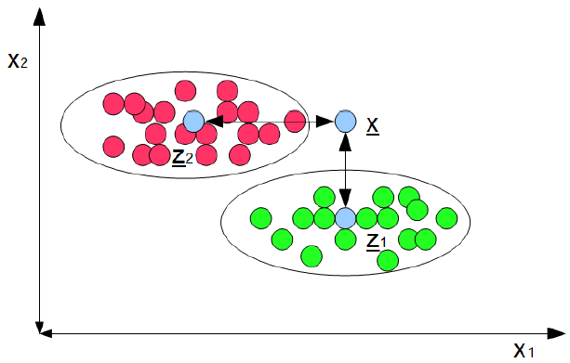
Example: Euclidean distance can cause problem
Weighted Euclidean Distance Metric
Orthonormal Covariance Transforms
Generalized Euclidean Metric
Minimum Intra-class Distance (MICD) Classifier
The Euclidean distance from x to class mean prototype z₁ is shorter than that to the cluster mean prototype z₂, even though intuitively it should belong to class 2.
Could use NN prototypes, but that is more computationally expensive and less robust to noise.

Slide 5
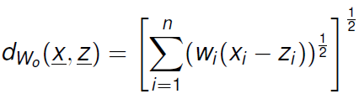

Weighted Euclidean distance metric
Weighted Euclidean Distance Metric
Orthonormal Covariance Transforms
Generalized Euclidean Metric
Minimum Intra-class Distance (MICD) Classifier
认为不同特征具有相同重要性的情况下！
Idea: Since the features may have different units, scales, and variances, why don’t we weight the features differently when measuring distances?
What we are doing is essentially scaling the feature axes with a linear transformation and then applying Euclidean distance metric.
Where x’=w₀x,z’=w₀x, and w₀ is a diagonal matrix of weights.

Slide 6
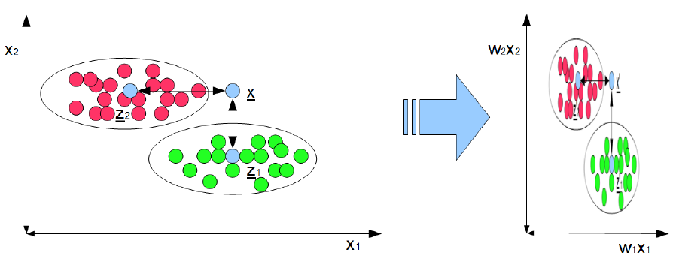
WED: visualization
Weighted Euclidean Distance Metric
Orthonormal Covariance Transforms
Generalized Euclidean Metric
Minimum Intra-class Distance (MICD) Classifier
The weighted Euclidean distance in the original feature space is just Euclidean distance in transformed space!

Slide 7
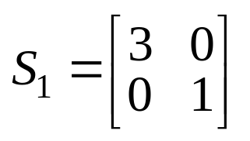
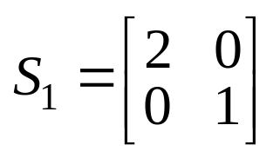
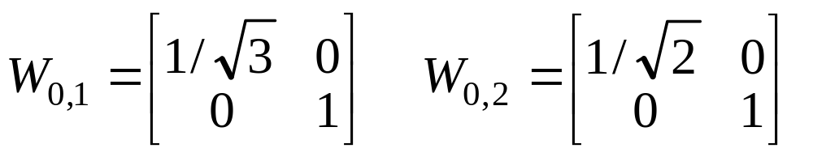
WED Classifier：Example
Weighted Euclidean Distance Metric
Orthonormal Covariance Transforms
Generalized Euclidean Metric
Minimum Intra-class Distance (MICD) Classifier
Suppose we are given the following statistical information about the classes:
  Class1: m₁=[3,3]^{T},
  Class2: m₂=[4,5]^{T},
Suppose we wish to build a WED classifier using sample means as prototypes and the following weight matrices W_{0,1} and W_{0,2}:
Compute the discriminate function for each class.
Compute the decision boundary

Slide 8
WED Classifier：Example
Weighted Euclidean Distance Metric
Orthonormal Covariance Transforms
Generalized Euclidean Metric
Minimum Intra-class Distance (MICD) Classifier
具体计算过程

Slide 9

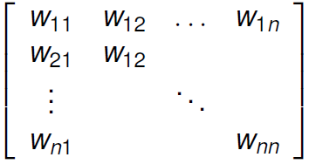
Weighted Euclidean distance metric
Weighted Euclidean Distance Metric
Orthonormal Covariance Transforms
Generalized Euclidean Metric
Minimum Intra-class Distance (MICD) Classifier
A more general form of the weighted Euclidean distance metric can be defined as:
Where W is the general weight matrix of the form:
Allows scaling AND rotation of axes!

Slide 10
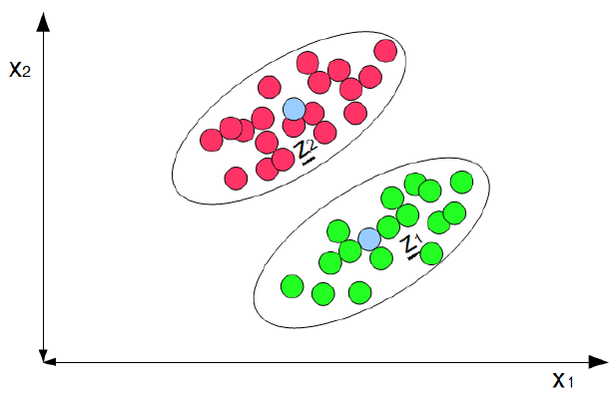
Weighted Euclidean distance metric
Weighted Euclidean Distance Metric
Orthonormal Covariance Transforms
Generalized Euclidean Metric
Minimum Intra-class Distance (MICD) Classifier
Question: Why do we care about rotation of the axes?
Answer: Cases like this …

Slide 11
Orthonormal Covariance Transforms
Weighted Euclidean Distance Metric
Orthonormal Covariance Transforms
Generalized Euclidean Metric
Minimum Intra-class Distance (MICD) Classifier
Question: how do we determine the weights W ?
Intuition: Euclidean distance is only valid for cases where features are:
  Uncorrelated
  Unit variance
Visually, shape of distribution in feature space is a hypersphere.
Therefore, we wish to find W that transforms the shape of the distribution into a hypersphere!

Slide 12
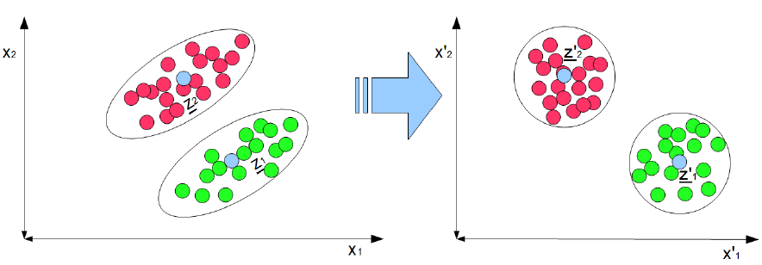
Orthonormal Covariance Transform
Weighted Euclidean Distance Metric
Orthonormal Covariance Transforms
Generalized Euclidean Metric
Minimum Intra-class Distance (MICD) Classifier

Slide 13
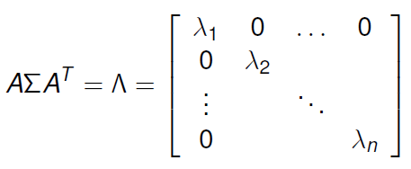
Orthonormal Covariance Transforms
Weighted Euclidean Distance Metric
Orthonormal Covariance Transforms
Generalized Euclidean Metric
Minimum Intra-class Distance (MICD) Classifier
Question: How do we compute this transfromation?
Intuition: As a first step, we wish to transform the samples into a space in which features are uncorrelated
This can be accomplished by finding the transform A that diagonalizes the covariance matrix ∑ (since non-zero non-diagonal elements in covariance matrix implies correlation)

Slide 14
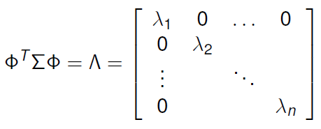

Orthonormal Covariance Transforms
Weighted Euclidean Distance Metric
Orthonormal Covariance Transforms
Generalized Euclidean Metric
Minimum Intra-class Distance (MICD) Classifier
A covariance matrix can be diagonalized based on the following formulation:
Where the columns of Φ are the eigenvectors of ∑, and the elements of are the eigenvalues.

Slide 15
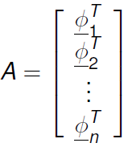
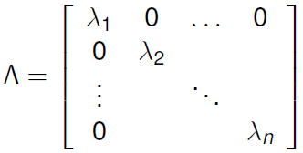
Orthonormal Covariance Transforms
Weighted Euclidean Distance Metric
Orthonormal Covariance Transforms
Generalized Euclidean Metric
Minimum Intra-class Distance (MICD) Classifier
Therefore, our transform A that diagonalizes ∑ is
The new covariance matrix in transformed space is

Slide 16
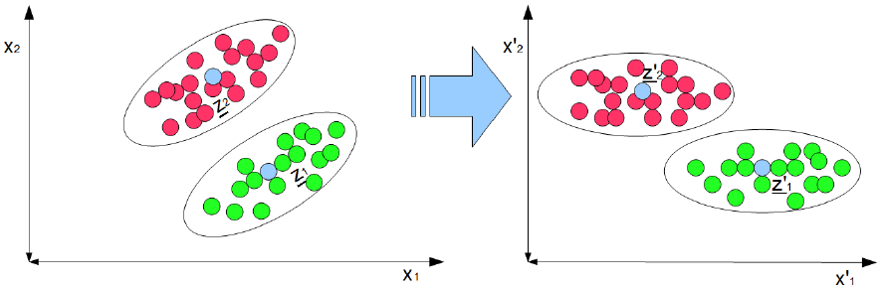
OCT: visualization
Weighted Euclidean Distance Metric
Orthonormal Covariance Transforms
Generalized Euclidean Metric
Minimum Intra-class Distance (MICD) Classifier

Slide 17
Gneralized Euclidean Metric
Weighted Euclidean Distance Metric
Orthonormal Covariance Transforms
Generalized Euclidean Metric
Minimum Intra-class Distance (MICD) Classifier
We wish to find a transform W that transform the samples into a space in which
  Feature are uncorrelated
  Feature have unit variance
The orthonormal covariance transform solves the first part of the problem(getting uncorrelated features)
Now we need to transform these uncorrelated features into ones with unit variances

Slide 18
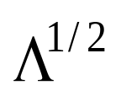
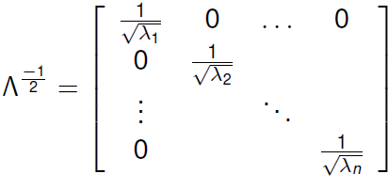
Generalized Euclidean Metric
Weighted Euclidean Distance Metric
Orthonormal Covariance Transforms
Generalized Euclidean Metric
Minimum Intra-class Distance (MICD) Classifier
Intuition:
The eigenvalues are the variances along the principal axes in the transformed space after orthonormal covariance transform
To achieve equal variance features, we just need to scale the feature axes based on their eigenvalues!
The necessary scaling transformation (whitening transformation) is

Slide 19
Generaized Euclidean Metric
Weighted Euclidean Distance Metric
Orthonormal Covariance Transforms
Generalized Euclidean Metric
Minimum Intra-class Distance (MICD) Classifier
Therefore, the weight matrix W that we want can be defined as:
What this weight matrix does is:
  First, rotate coordinate axes to get diagonal covariance matrix
  Second, scale the axes to obtain identity matrix

Slide 20
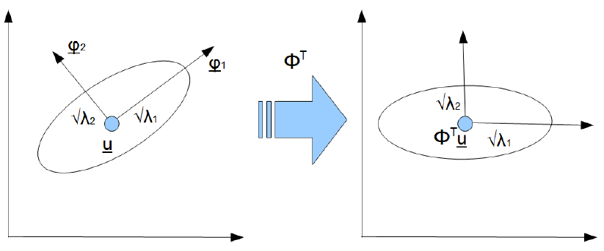
GEM: visualization
Weighted Euclidean Distance Metric
Orthonormal Covariance Transforms
Generalized Euclidean Metric
Minimum Intra-class Distance (MICD) Classifier

Slide 21
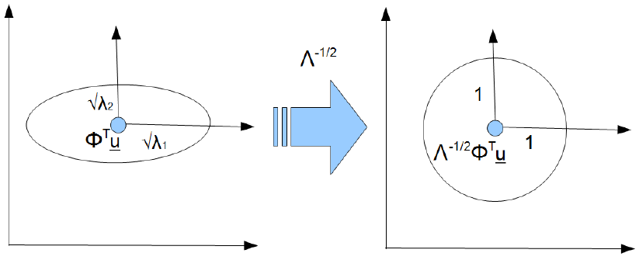
GEM: visualization
Weighted Euclidean Distance Metric
Orthonormal Covariance Transforms
Generalized Euclidean Metric
Minimum Intra-class Distance (MICD) Classifier

Slide 22

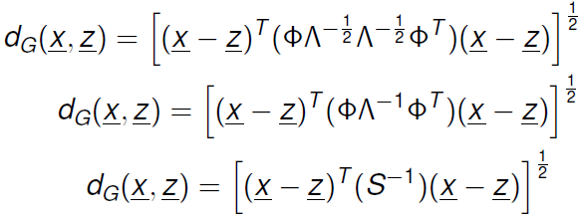
Generalized Euclidean Metric
Weighted Euclidean Distance Metric
Orthonormal Covariance Transforms
Generalized Euclidean Metric
Minimum Intra-class Distance (MICD) Classifier
Given W, the final generalized Euclidean metric is
Simplifying the formulation gives:
Makes perfect sense since S⁻¹S=I , thus giving us features that are uncorrelated and have unit variance

Slide 23
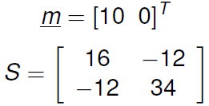
Generalized Euclidean Metric: Example
Weighted Euclidean Distance Metric
Orthonormal Covariance Transforms
Generalized Euclidean Metric
Minimum Intra-class Distance (MICD) Classifier
Given a class with the following mean and covariance matrix:
Plot unit standard deviation contour in original space.
Find the transformation that yields equal, unit variance features. Plot unit standard deviation contour in transformed space.

Slide 24
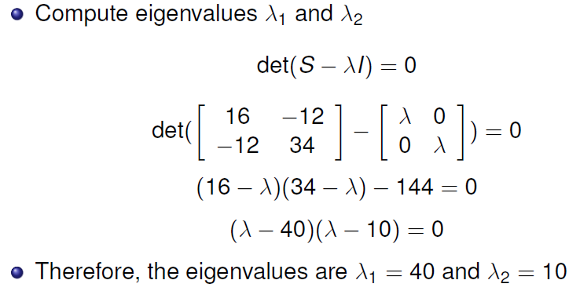
Generalized Euclidean Metric: Example
Weighted Euclidean Distance Metric
Orthonormal Covariance Transforms
Generalized Euclidean Metric
Minimum Intra-class Distance (MICD) Classifier
具体计算

Slide 25
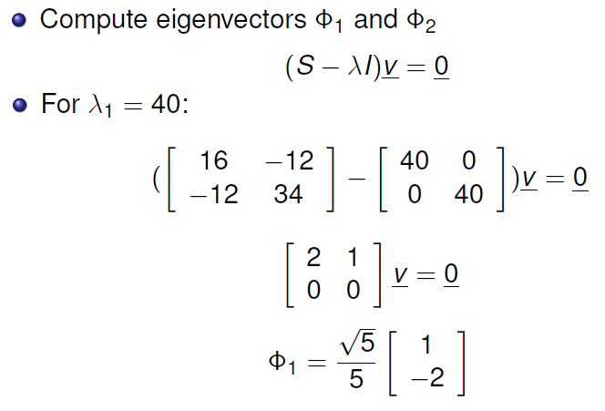
Generalized Euclidean Metric: Example
Weighted Euclidean Distance Metric
Orthonormal Covariance Transforms
Generalized Euclidean Metric
Minimum Intra-class Distance (MICD) Classifier
具体计算

Slide 26
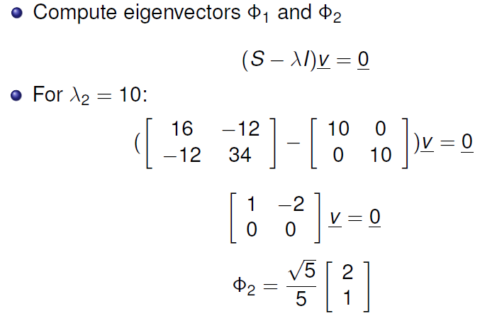
Generalized Euclidean Metric: Example
Weighted Euclidean Distance Metric
Orthonormal Covariance Transforms
Generalized Euclidean Metric
Minimum Intra-class Distance (MICD) Classifier
具体计算

Slide 27
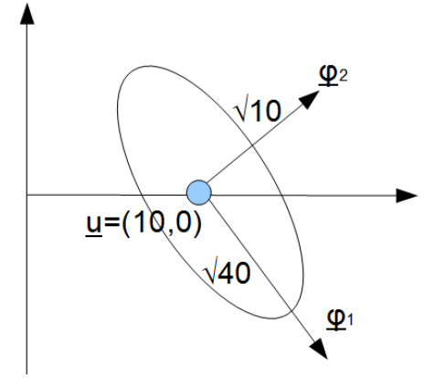
Generalized Euclidean Metric: Example
Weighted Euclidean Distance Metric
Orthonormal Covariance Transforms
Generalized Euclidean Metric
Minimum Intra-class Distance (MICD) Classifier
Sketch unit standard deviation contour in original space

Slide 28
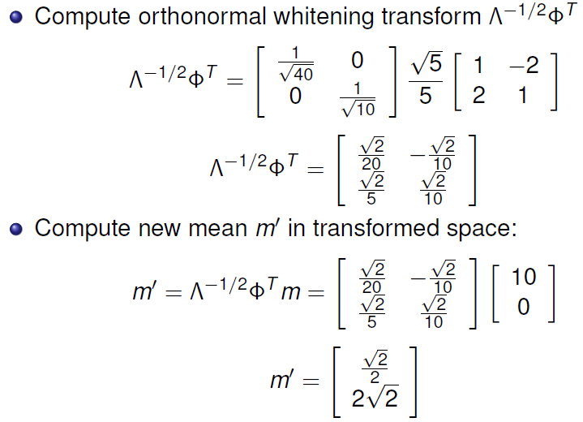
Generalized Euclidean Metric: Example
Weighted Euclidean Distance Metric
Orthonormal Covariance Transforms
Generalized Euclidean Metric
Minimum Intra-class Distance (MICD) Classifier
具体过程

Slide 29
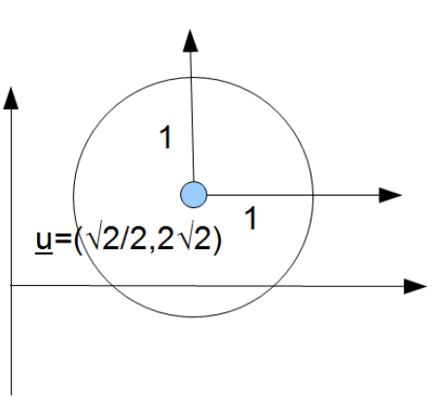
Generalized Euclidean Metric: Example
Weighted Euclidean Distance Metric
Orthonormal Covariance Transforms
Generalized Euclidean Metric
Minimum Intra-class Distance (MICD) Classifier
Sketch unit standard deviation contour in transformed space

Slide 30
Minimum Intra-Class Distance (MICD) Classifier
Weighted Euclidean Distance Metric
Orthonormal Covariance Transforms
Generalized Euclidean Metric
Minimum Intra-class Distance (MICD) Classifier
For classification, we want to maximize within class similarity
In terms of distance metrics, we want to minimize intra-class distance
How do we judge intra-class distance?
  A reasonable objective measure is the mean squared distance within the class
Based on the criterion of minimum mean squared distance within classes, the generalized Euclidean metric IS the minimum intra-class distance metric!

Slide 31
Minimum Intra-Class Distance (MICD) Classifier
Weighted Euclidean Distance Metric
Orthonormal Covariance Transforms
Generalized Euclidean Metric
Minimum Intra-class Distance (MICD) Classifier
The MICM classifier is defined by the following decision rule:
Important observations:
  The distance to each class is measured with its own metric determined by its own covariance matrix (e.g., x is transformed by S_{A}⁻¹ to compute d_{MICD}(x,m_{A}), while x is transformed by S_{B}⁻¹ to compute d_{MICD}(x,m_{B}))
  Means that while a linear transformation is associated with each metric, it is not possible in general to map both hyperellipsoidal distributions to hyperspheres with the same transformation.

Slide 32
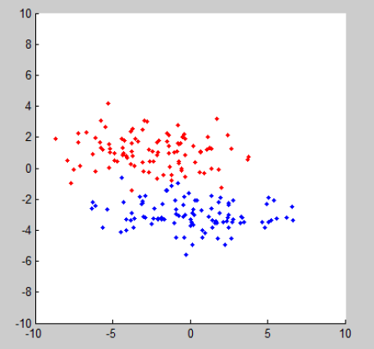
Example: simple classification problem
Weighted Euclidean Distance Metric
Orthonormal Covariance Transforms
Generalized Euclidean Metric
Minimum Intra-class Distance (MICD) Classifier
Features are Gaussian in nature, different means, uncorrelated, different variances

Slide 33
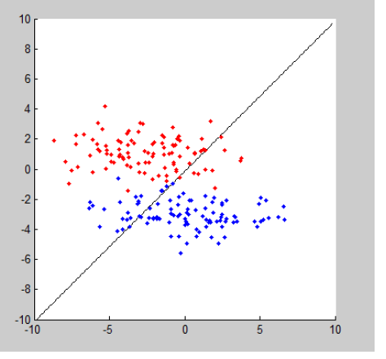
Example: simple classification problem
Weighted Euclidean Distance Metric
Orthonormal Covariance Transforms
Generalized Euclidean Metric
Minimum Intra-class Distance (MICD) Classifier
MED decision boundary

Slide 34
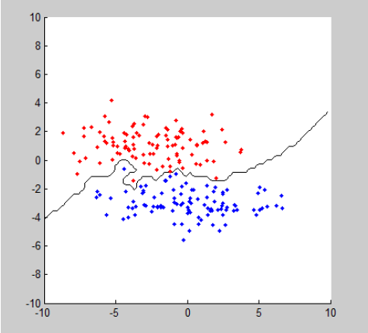
Example: simple classification problem
Weighted Euclidean Distance Metric
Orthonormal Covariance Transforms
Generalized Euclidean Metric
Minimum Intra-class Distance (MICD) Classifier
NN decision boundary:

Slide 35
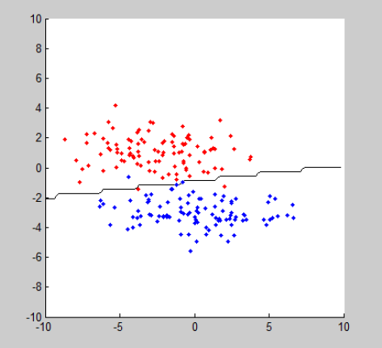
Example: simple classification problem
Weighted Euclidean Distance Metric
Orthonormal Covariance Transforms
Generalized Euclidean Metric
Minimum Intra-class Distance (MICD) Classifier
MICD decision boundary:

Slide 36
Why does MICD make sense?
Weighted Euclidean Distance Metric
Orthonormal Covariance Transforms
Generalized Euclidean Metric
Minimum Intra-class Distance (MICD) Classifier
From a quick glance, there are some questions that seem to arise when trying to understand the IMCD classifier:
  Why does performing distance comparisons between a pattern and class prototypes in different transformed feature spaces make sense?
  What distance are we really measuring when we compare a pattern and class prototype in a transformed feature space?

Slide 37
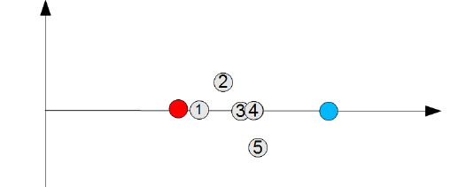
Why does MICD make sense?
Weighted Euclidean Distance Metric
Orthonormal Covariance Transforms
Generalized Euclidean Metric
Minimum Intra-class Distance (MICD) Classifier
To answer these questions, let’s first take a look at a simple example
Based on the current units in this feature space, where does each of these patterns(in gray) belong to based on Euclidean distance?

Slide 38
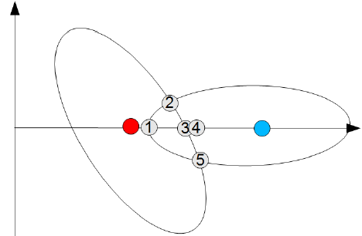
Why does MICD make sense?
Weighted Euclidean Distance Metric
Orthonormal Covariance Transforms
Generalized Euclidean Metric
Minimum Intra-class Distance (MICD) Classifier
Suppose that I now tell you that the classes have the following statistical distributions
Based on this new information, where should they belong to now?

Slide 39
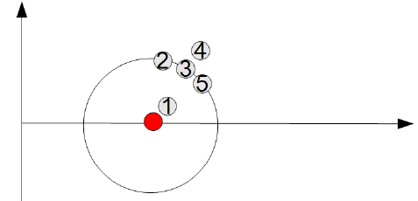
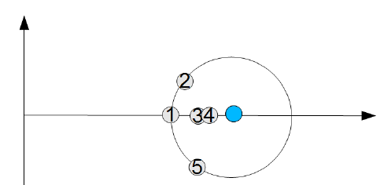
Why does MICD make sense?
Weighted Euclidean Distance Metric
Orthonormal Covariance Transforms
Generalized Euclidean Metric
Minimum Intra-class Distance (MICD) Classifier
Let’s transform the patterns relative to the statistics of Class A and Class B:

Slide 40
Why does MICD make sense?
Weighted Euclidean Distance Metric
Orthonormal Covariance Transforms
Generalized Euclidean Metric
Minimum Intra-class Distance (MICD) Classifier
Looking at the features in the transformed spaces for class A and class B, we can now answer the question: what distance are we really measuring when we compare a pattern and class prototype in a transformed feature space?
  To get into the transformed feature space for each class, we normalize the feature axes by its standard deviation for each feature.
  What that means is that the new unit of measure in the transformed space is now in terms of the number of standard deviations.

Slide 41
Why does MICD make sense?
Weighted Euclidean Distance Metric
Orthonormal Covariance Transforms
Generalized Euclidean Metric
Minimum Intra-class Distance (MICD) Classifier
Knowing that the distance between a pattern and the prototype of a class is now measured in units of standard deviation, we can now see how doing distance comparisons between a pattern and class prototypes make sense by taking a look at each of the patterns.
  In Euclidean space, pattern 3 is three units from A and four units from B, so it is classified as A.
  In the transformed spaces, pattern 3 is one standard deviation from A and less than one standard deviation from B, so it is classified as B.
  In Euclidean space, pattern 4 is 3.5 units from A and 3.5 units from B, so it can be A or B.
  In the transformed space, pattern 4 is greater than one standard deviation from A and less than one standard deviation from B, so it is classified as B.

Slide 42

MICD Decision Boundaries
Weighted Euclidean Distance Metric
Orthonormal Covariance Transforms
Generalized Euclidean Metric
Minimum Intra-class Distance (MICD) Classifier
Unlike the Eunclidean distance classifier, the decision boundaries between class regions are general NOT linear.
So how do we determine the decision boundaries?
  Recall that patterns here are equally similar (e.g., same distance) to both classes
  Therefore, the decision boundaries lie on the intersections of the corresponding equidistance contours around the classes.
  The equidistance contour for a class A can be defined as:

Slide 43

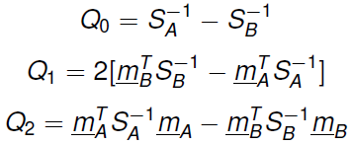
MICD Decision Boundaries
Weighted Euclidean Distance Metric
Orthonormal Covariance Transforms
Generalized Euclidean Metric
Minimum Intra-class Distance (MICD) Classifier
So how do we determine the decision boundaries?
  The intersection of the corresponding equidistance contours around the classes is
  Expanding and simplifying leads to the general quadratic surface in hyperspace:
  Where

Slide 44
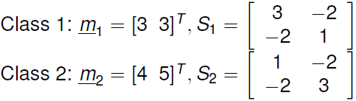
MICD classifier: example
Weighted Euclidean Distance Metric
Orthonormal Covariance Transforms
Generalized Euclidean Metric
Minimum Intra-class Distance (MICD) Classifier
Suppose we are given the following statistical information about the classes:
Suppose we wish to build a MICD classifier using sample means as prototypes.
  Compute the discriminate function for each class
  Compute the decision boundary

Slide 45
MICD classifier: example
Weighted Euclidean Distance Metric
Orthonormal Covariance Transforms
Generalized Euclidean Metric
Minimum Intra-class Distance (MICD) Classifier
计算过程
编程画图

Slide 46
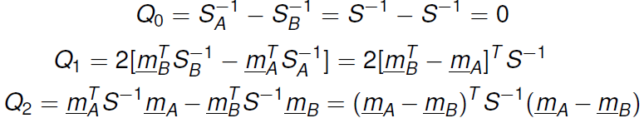
Decision boundaries: different cases
Weighted Euclidean Distance Metric
Orthonormal Covariance Transforms
Generalized Euclidean Metric
Minimum Intra-class Distance (MICD) Classifier
Case 1: different means, equal covariance
The parameters become:
This gives us the final decision boundary:
This is just a straight line through (m_{A}+m_{B})/2 (i.e., midpoint between the means), with a slope that’s influenced by S.

Slide 47
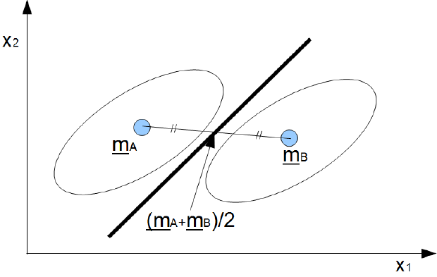
Decision boundaries: different cases
Weighted Euclidean Distance Metric
Orthonormal Covariance Transforms
Generalized Euclidean Metric
Minimum Intra-class Distance (MICD) Classifier
Case 1

Slide 48
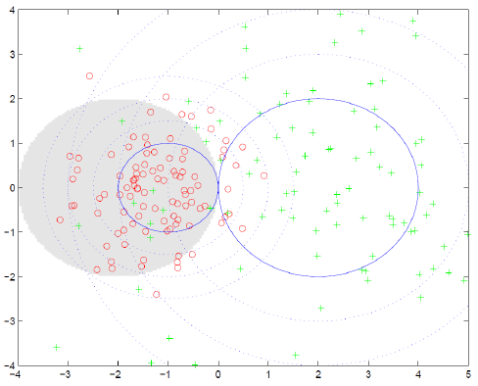
Decision boundaries: different cases
Weighted Euclidean Distance Metric
Orthonormal Covariance Transforms
Generalized Euclidean Metric
Minimum Intra-class Distance (MICD) Classifier
Case 2: different means, different covariance, uncorrelated features. For example:

Slide 49
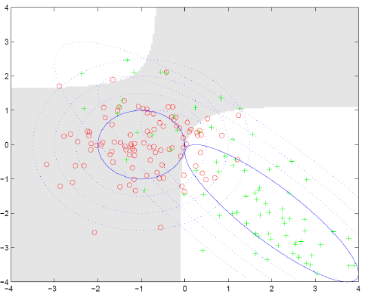
Decision boundaries: different cases
Weighted Euclidean Distance Metric
Orthonormal Covariance Transforms
Generalized Euclidean Metric
Minimum Intra-class Distance (MICD) Classifier
Case 3: different means, different covariance, correlated features. For example:

Slide 50
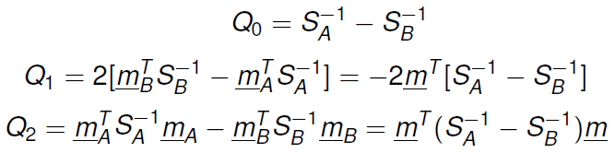

Decision boundaries: different cases
Weighted Euclidean Distance Metric
Orthonormal Covariance Transforms
Generalized Euclidean Metric
Minimum Intra-class Distance (MICD) Classifier
Case 4: same means, different covariance
The parameters become:
This gives us the final decision boundary：
This surface is complicated in general, but can be visualized more easily on some special cases.

Slide 51


Decision boundaries: different cases
Weighted Euclidean Distance Metric
Orthonormal Covariance Transforms
Generalized Euclidean Metric
Minimum Intra-class Distance (MICD) Classifier
Example: suppose that we have only one feature (n=1) and m=0
Given the MICD decision boundary for Case 4:
We get the following:
The only solution for this equation is x=0!

Slide 52


Decision boundaries: different cases
Weighted Euclidean Distance Metric
Orthonormal Covariance Transforms
Generalized Euclidean Metric
Minimum Intra-class Distance (MICD) Classifier
Therefore, given the MICD classification rule:
The x’s cancel out
The MICD classification rule decides in favor of the class with the largest variance, regardless of x!

Slide 53
Decision boundaries: different cases
Weighted Euclidean Distance Metric
Orthonormal Covariance Transforms
Generalized Euclidean Metric
Minimum Intra-class Distance (MICD) Classifier
Why does this happen?
  When applying MICD, distance is really measured in units of standard deviation.
  Therefore, any unknown x is always closer to m=0 with the metric for the class with largest variance (the transform that scales that cluster’s class to unit standard deviation is larger, thus pulling any unknown x closer to m=0)
However, given a Gaussian distribution, the class with higher standard deviation would have a lower probability near m=0
Therefore, MICD is sub-optimal in this case!

Slide 54


Decision boundaries: different cases
Weighted Euclidean Distance Metric
Orthonormal Covariance Transforms
Generalized Euclidean Metric
Minimum Intra-class Distance (MICD) Classifier
Example in n=2: same means, diff. covariance
Mean: m_{a}=m_{b}=m=[0,0]^{T}
Covariances:
Recall that the MICD decision boundary for this case is:

Slide 55
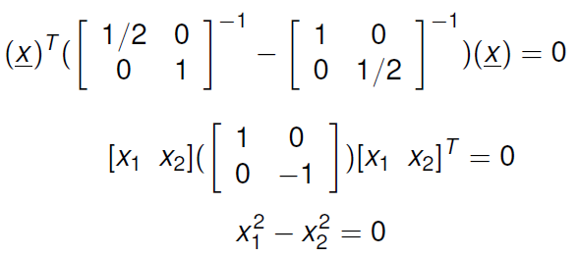
Decision boundaries: different cases
Weighted Euclidean Distance Metric
Orthonormal Covariance Transforms
Generalized Euclidean Metric
Minimum Intra-class Distance (MICD) Classifier
Plugging in the mean and covariance terms give us:
The solution to this equation is x₁ =±x₂

Slide 56
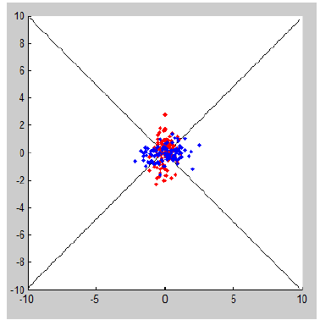
Decision boundaries: different cases
Weighted Euclidean Distance Metric
Orthonormal Covariance Transforms
Generalized Euclidean Metric
Minimum Intra-class Distance (MICD) Classifier
Plotting the decision boundary gives us

Slide 57
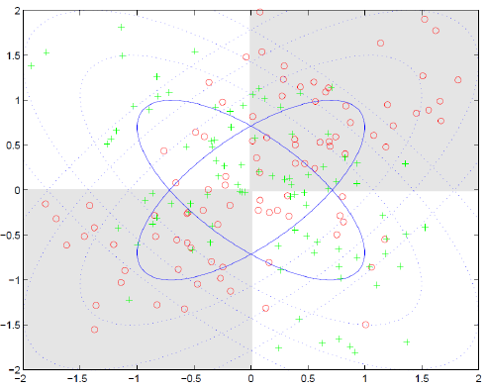
Decision boundaries: different cases
Weighted Euclidean Distance Metric
Orthonormal Covariance Transforms
Generalized Euclidean Metric
Minimum Intra-class Distance (MICD) Classifier
Example: same means, different variances, correlated features
Example:

Slide 58
Advantages and disadvantages
Weighted Euclidean Distance Metric
Orthonormal Covariance Transforms
Generalized Euclidean Metric
Minimum Intra-class Distance (MICD) Classifier
Advantages: lower sensitivity to noise and outliers, great for handling class distributions that are well modeled by Gaussian models (e.g., mean and variance)
Disadvantages: poor at handling more complex class distributions
Need to develop more power classifiers based on more complete information about the probabilistic behavior of the classes.

Slide 59
Where can I use any of them?
Here is one interesting application of these concepts: motion tracking for video games!(e.g., Microsoft Kinect)

